Slide 1
The recording for this week
Topic: CS2040C Wednesday Lectures
Start Time : Aug 25, 2021 09:48 AM
Meeting Recording:
https://nus-sg.zoom.us/rec/share/Kw_G5Avu9RNGCXdImebPOkJ4tAKnHhupAlE3b5xRXZ4VvFajlYwAbimZqTDblAAP.TWM-Un7BybXbsQBS
Access Passcode: 1HWAS%%K
=======================
Topic: CS2040C Thursday Lectures
Start Time : Aug 26, 2021 04:42 PM
Meeting Recording:
https://nus-sg.zoom.us/rec/share/pAattDSCNIJSMQVMPOqPZiu2S7fOke622dlZQ6LG5W2NucEtSLoY8wg8lE_YeJ_T.5wkZ0z8SGvdd9OzZ
Access Passcode: X9Dx68W#

Slide 2
CS2040C
Week 03 guideline slides

Slide 3
Admins – Wed (1)
Remarks on PS1: https://nus.kattis.com/sessions/vpw8rg
Proper comments/indentation/code style are NOT enforced IF your submissions are green with 100+100=200 points AND you are not copying from anyone
But still good to have ☺
But all those are needed if your last submission (especially /universityzoning) is still not 100+100=200 points as a human TA will read your code
As of Tue, 24 Aug 2021, 5pm, Kattis caught no confirmed plagiarism for PS1 ACs yet
Reminder: Do not use two different Kattis accounts and submit same/similar code :O
Most false alarms involving students using TWO different accounts (illegal according to Kattis’s ToS)
/universityzoning only has very few ACs (~100) worldwide so far, we will KNOW if you copy
https://open.kattis.com/problems/universityzoning/statistics

Slide 4
Admins – Wed (2)
Division of Concerns between Lab+Tutorial TA and the Lecturer
For Tutorial (the first 1 hour of Lab+Tutorial combo), your TA is responsible for:
The theoretical content of the module (including understanding of lecture demo code)
Ensure students in his tutorial group can follow weekly lessons pace
For Lab/hands-on (the second 1 hour of Lab+Tutorial combo), your TA is responsible for:
Answering your PS related (or lecture demo C++ code) questions
Give (some) hints on PSes (more hints towards end of PS, near zero hint at the start of PS)
Generally: NOT debug your code before deadline :O
Manually grade the last red submission of your PS, skim thru your greens for plagiarism reports (if any)
Give you feedback for non AC code after deadline
Will also try to give some (minimal) feedback even for an AC code
Random stuffs @ Discord channels,
There are TAs, a super-senior (rawr), and myself (the lecturer) who will respond as and when we are free
Your Lecturer: Please kindly don’t use me as first channel…
Private email/Discord DM to me directly to ask CS2040C stuff is discouraged…

Slide 5
Sorting demo, continued
Kattis – sortofsorting (continuation from last Thursday)
Custom (lambda) comparison function (since C++11)
stable sorting (default in Python list.sort() and Java Collections.sort, but we need to specifically use std::stable_sort instead of std::sort in C++)
To save time, Steven will just show his AC code and diff the two submissions (with std::sort versus with std::stable_sort)
Notes:
Kattis – sortofsorting, stable sorting, special comparison function (first two characters only), lambda function (C++11/Java)

Slide 6
Sorting, O(N log N) sorting algorithms
https://visualgo.net/en/sorting?slide=10 to 13-1
Q&A two (and half) O(N log N) sorting algorithms: Merge Sort, Quick Sort and its Randomized version (also see SortingDemo.cpp/py/java)
My questions to you (if not already asked above)
Why Merge Sort needs temporary array b?
Why I/we choose a[i] as pivot for partitioning a[i..j]?
How to actually implement randomized quick sort? Is the one @ VA really runs in ‘expected O(N log N)’?
Note that some answers to VisuAlgo hidden e-Lecture slides are available as slide notes of this PowerPoint slide
Notes:
Wrong overwrite otherwise, you can try it yourself (btw, we have merge sort variants that tackle this issue, see Wikipedia page https://en.wikipedia.org/wiki/Merge_sort#Variants, Steven hasn’t explore them yet)
We pick a[i] just for convenience, any index between [i..j] can be pivot candidate (revisited during randomized Quick Sort discussion)
Shown in SortDemo.cpp, be careful in putting duplicates always in S2… randomize it (50-50) between S1 and S2 (>= than pivot) or split into three region s1, equal to pivot, s2 (strictly > than pivot), or use modified partition routine that returns a pair of indices [x, y] where x is the first occurrence/lower_bound index of pivot and y is the last occurrence/upper_bound index of pivot, then we only recurse to [lo..x-1] and [y+1..hi]. Most of the time x == y, but on duplicate cases, this will help A wrong implementation (like the one still in VA sorting page) can degenerate to O(N^2) again on test case where all items are equal...
For CS2040/IT5003, see SortDemo.java/py instead of SortDemo.cpp

Slide 7
Sorting, non-comparison based, O(N)
https://visualgo.net/en/sorting?slide=14 to 16-1
Q&A O(N) sorting algorithms: Lower bound of Comparison-based sorting, Counting Sort, and Radix Sort (code “not shown”)
My questions to you (if not already asked above)
Counting Sort runs in O(N+k) and Radix Sort that uses Counting Sort d times runs in O(d * (N+k)). If d and k are “small”, then both are O(N). So, if Radix Sort is faster than O(N log N) Merge Sort or expected O(N log N) Randomized Quick Sort, should we just use Radix Sort all the time?
What if d and/or k are “not that small” (or play an important role and cannot be ignored)?
Notes:
There are a few reasons why Radix Sort is less universal than O(N log N) comparison-based sort, among others: if the integer digits are many (technically, if we have more than log_2 n bits, it is better to just use optimal O(N log N) comparison-based sort), if what we are sorting are not integers but floating point numbers with high degree of precision, not in place (counting sort requires extra memory), etc. 99% if not all sort library routines in various programming languages use O(N log N) (or expected O(N log N)) version of comparison-based sorting…
That was last year’s PS1 B, more tormenting /magicsequence… many of your seniors died with this one, see https://open.kattis.com/problems/magicsequence/statistics

Slide 8
Sorting, Misc Stuffs
https://visualgo.net/en/sorting?slide=16 to end
Q&A on Misc sorting stuffs
My questions to you (if not already asked above)
Why (typical/my implementation of) Merge Sort is a stable sort algorithm?
Why (Randomized) Quick Sort (as presented in VA) is by default not stable?
For advanced discussions outside class:
What is std::partial_sort? What does it do? Is it important?
What about dynamic sort? (we need to keep a sorted list but we can add new, delete existing number, or change the value of existing number frequently)
Caching stuff is only for those who have taken Computer Organization
Other custom comparison functions
Notes:
Consider what Merge Sort will do if there is/are duplicates, e.g. try sorting A = {4a, 4b, 1, 2}, the current implementation as shown in VA is stable, we can make it unstable though by implementing it differently (change <= to < in the merge routine when we compare the front of two sorted sublists)
Try sorting A = {3, 4a, 2, 4b, 1}, the randomized one is quite clear, but even the non randomized Quick Sort does not guarantee stability. Remarks: There are ways to make it stable though, but not the one currently presented in VA (associate increasing distinct ids for each element in O(n) initial pre-processing pass; this way, all n items will be distinct again ☺), e.g., A earlier becomes = {3a, 4b, 2c, 4d, 1e}.
Advanced:
Can be skipped until Priority Queue (Binary Heap) lecture
Can be skipped until Balanced Binary Search Tree lecture; PS: if we use array, during deletion we still need to “close the gap”, that can still be O(N) :’( even though the sort order is not disrupted. Repeated insertion during each add is O(N)
Usually too hard to understand by many students without understanding about cache memory, you can read stuffs like https://stackoverflow.com/questions/12065774/why-does-cache-locality-matter-for-array-performance
Will have some exercise during lab session

Slide 9

Flipped Classroom Continued
That’s the end for sorting topics…
https://nuswhispers.com/confession/57486
Youcandueet
By tomorrow, you all should have started reading the next topic
https://visualgo.net/en/list?slide=1
https://visualgo.net/en/list?slide=2 to 2-8 are discussed in Tut01 actually
Focus on self teach yourself on https://visualgo.net/en/list?slide=3 to 3-22
We will discuss this data structure tomorrow ☺

Slide 10
Before starting L03b
Try https://visualgo.net/training?diff=Medium&n=5&tl=0&module=sorting live
Keep doing this e-training every week for that week’s topic
When I finish upgrading VisuAlgo to have user-tracking system, the tool will remind you weekly instead of me

Slide 11
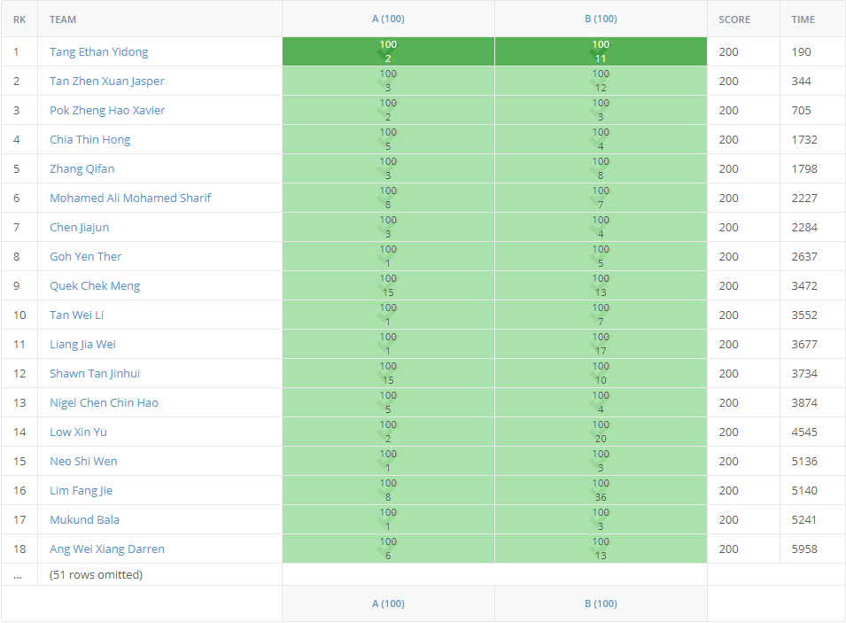
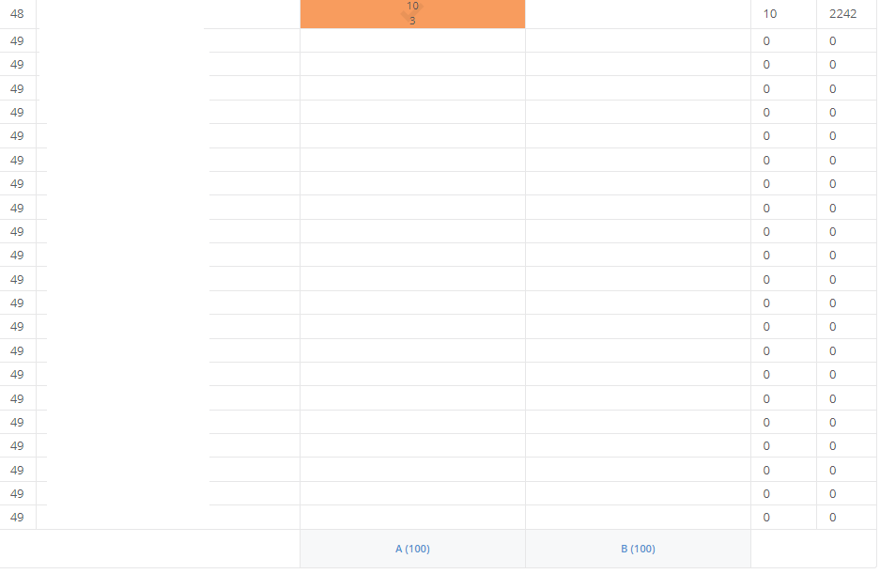
Admins – Thu (as of Wed, 25 Aug, 4.45pm)
PS1 top 18, good job ☺
PS1 bottom side (20+ rows, start soon!)

Slide 12
Linked List, review of List ADT
https://visualgo.net/en/list?slide=1 to 2-8
Note that these slides have been discussed in Tut01/Lab01 earlier this week
Q&A on Basic List ADT stuffs:
What is an ADT actually? And for this lecture: List ADT?
Are there other operations for List ADT?
Do you understand how to use vector (C++)/list (Python)/ArrayList (Java) for List ADT?
To be explored at home by yourself:
What happens to List ADT implementation if we use non compact array?
What is the main issue of compact array for List ADT implementation?
Notes:
Abstract Data Type: data, its possible values/contents, and possible operations on data, not concerning the actual implementation; List ADT is like what we discussed, a mathematical model to describe a collection of (similar type objects) that referred via their indices; common operations: get(i), search(v), insert(i, v), remove(i).
Perhaps remove(specific-value) --- be careful of accidental Run Time Error if specific-value doesn’t exist, isEmpty(), printList(), sortList()?
We have used vector [] (for get), will? use vector insert(pos, value) for insert(i, v), erase(pos) for erase(i), and can use STL std::find in <algorithm> for search(v). However, it does not solve the space wastage (not that important though as memory is ‘cheap’ nowadays) and content shifting problems during insert/remove though…
Others:
Much more complicated to implement correctly and efficiently, it has been asked in a recent past paper
Fixed size

Slide 13
Linked List, review of basic (Single/y) LL
https://visualgo.net/en/list?slide=3 to 3-22
Q&A on Basic Single/y LL stuffs:
Review: SLLDemo.cpp/py/java, a basic SLL demo C++/Python/Java code by stitching this (Vertex class/struct), this (get a particular index), this (insert at head), and this (remove at head), in yet another demonstration of C++/Python/Java class
To be explored at home by yourself:
List ADT insert(i, v): Array vs Linked List: round 1, round 2, round 3
List ADT remove(i): Array vs Linked List: round 1, round 2
That SLL by itself is basically ‘not that useful’ when compared with C++ vector/Python list/Java ArrayList
Notes:
Only for CS2040C: C struct or C++ class for Linked List Vertex/Node?
Up to you, both are okay
[cannot be done this time due to online class] : We will use humans to emulate SLL ☺
Standard stuffs
Others:
Round 1: Array wins, Round 2: LL wins, Round 3: Tie
Round 1: LL wins, Round 2: Array wins
What SLL can do, we can emulate (and slightly better) with std::vector; SLL’s main strength is in the way it allows the vertices to be non-contiguous in memory, which will be used more in Stack ADT and especially Queue ADT; on some application that requires fast delete/fast insertion without needing to close the gap, we may need SLL/DLL, will be reiterated in Lecture 04a

Slide 14
Next e-Lecture for our Flipped Classroom
Read https://visualgo.net/en/list?slide=4 to end
Super duper lost otherwise…
We will complete the discussion of linked list when we meet again: Stack, Queue, DLL, Deque

